Slide 1

Hello.
Evolving your Power BI Architecture using Dataflows and Shared Datasets
Agenda
History lesson: Microsoft BI Enterprise Architecture
Power BI Architecture. Simple.
Dataflows
Shared Datasets
Power BI Architecture. Evolved.
Link to slides

Slide 2





Ben Watt. At your service!
ben@datalineo.com
@benrebooted
linkedin.com/in/benonline
What I do:
Managing Director at Datalineo
Microsoft MVP Data Platform
Power BI: SQL/Azure/Power Platform
Dublin PUG leader
Event Co-Ordinator:
Data Ceili
Power Platform WT

Slide 3













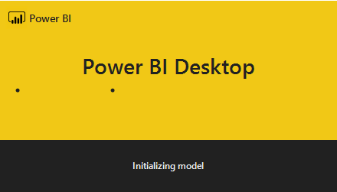
The Process
Trigger
Actions
Face API – Facial Attributes
Flow
For every attachment
Face API - Recognition
Store it in Azure Blob
Write to SQL
Email with images attached
Write to streaming dataset
Reply with Image Description(s)
Write to SQL
Computer Vision
Write to SQL
Power BI
Streaming Dashboard
Image Analytics Report

Slide 4

Thank you!
ben@datalineo.com
@benrebooted
linkedin.com/in/benonline
Slides, etc:
https://github.com/datalineo/sessions/EvolvePowerBIArchitecture

